Slide 1
Getting Things back on track
Analysing the Decline in the Usage of the Armadale Trainline
The Three Pymigos
(Luis, Lucas & Savy)

Slide 2
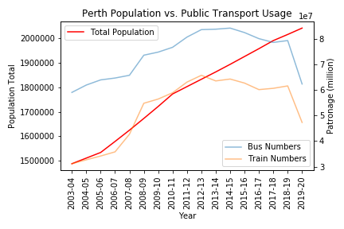
The question
We started this investigation with a simple question, why have public transport numbers started to decline in Perth as its population continues to grow.

Slide 3
Trainline comparison

Slide 4
The question
The last decade in Perth has been defined by a surge in population growth on the back of the mining boom. As the economy transitions out of this ’boom’ period it is important to identify the factors that may be causing this if the government wants to improve these numbers going forward.
By breaking down the data by per trainline we identified, the Armadale Line had the most notable decline.
With that in mind we decided to analyse the demographics of the people living alongside the trainline to identify the impact of economic and social indicators on this overall trend.

Slide 5
The hypothesis
With such a large range of factors affecting patronage of trainline, we decided to focus on what we saw to be key factors broken down by the different trainlines to identify how much if any of a contributing factor they had been to the decline.
For this investigation we decided to focus on the Armadale Line, using Joondalup and Mandurah as reference points. As they were both trainlines that had held fairly consistent patronage numbers over the same period.
Through this we looked to test the hypothesis that the decline in numbers was due to factors localized to the Armadale area.

Slide 6
Key factors
Changes to overall and working population
Increasing proximity to businesses and work
Changing consumer choices surrounding transport

Slide 7
Sourcing data
The primary source of data for us was the ABS website and other government websites with a focus on Local governments
Initially tried to source data using apis, but ended up struggling to get a productive result from it

Slide 8
Demographic factors: total population
This heat map shows the areas of the Perth metropolitan area with the greatest change in population
The major changes have been south of the river along the Mandurah and Armadale lines and far north at the end of the Joondalup line.

Slide 9
Demographic factors: working population
This heat map shows the areas of the Perth metropolitan area with the greatest change in working population.
Whilst similar to previous heatmap, it’s important to acknowledge the additional hot spots closer to the CBD.

Slide 10
Demographic factors: employment
To identify the change in population using the trainline for work we compared the variation in unemployment and those working from home between the trainlines.

Slide 11
Demographic factors: Business numbers
By looking through the change in the number of local businesses relative to the population we can identify whether an increase in proximity to services may have lead to the decline in patronage. As the numbers increased or remained stable across the trainlines we can assume that it wasn’t a major contributing factor.
It has to be noted that we don’t know what types of businesses have been created as this may alter the need of the use of public transport.

Slide 12

Demographic factors: employment WORKING POPULATION
To test this we compared the numbers across the trainlines, testing the null hypothesis to identify whether this changes were independent from each other.
Through this we generated a p-value of 0.673, which indicates a high likelihood that these changes were driven by external factors common to all lines.

Slide 13
Shift to Cars: Car population
A surprising trend we found is that over recent years the number of cars as a ratio of the population has begun to decline along the Armadale line relative to other trainlines.
This contrasts with the idea that lower car numbers would lead to higher PT numbers

Slide 14
Shift to cars: Travel choices
To analyse the change in travel choices for the population we looked at the variation in what transport options used to get to work.
As you can see there is a consistent jump in workers travelling by car across the three trainlines

Slide 15
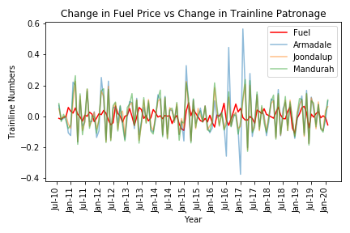
Shift to cars: fuel prices
Trainline | Correlation | P-value
Armadale | 0.066 | 0.482
Mandurah | 0.113 | 0.230
Joondalup | 0.138 | 0.141
Total Lines | 0.087 | 0.355

Slide 16
Other factors
Local
Closure of trainlines
Proximity of essential services
Income
Crime rates
External
New freeways and other changes to infrastructure.
Optus Stadium
The surge in ride sharing and other transport alternatives cabs.
Changes to bus and train services, fees and routes

Slide 17
Limitations of Results
Limitations of ABS data; hard to get consistent periods for all data over the time we were looking at.
Lack of recent data over the last few years.
Did not use comparison data across all trainlines
Used data for LGAs not suburbs.
A number of overlooked factors that we failed to include in analysis.
Intangible factors that drive behavioural changes.

Slide 18
Conclusion
The decline in public transport usage, unsurprisingly is due to a number of different circumstances and factors. Whilst we were unable to find an obvious candidate for the decline, we did identify that the decline is likely due to factors affecting Perth as a whole, not specific parts of the metropolitan area.

Slide 19
Questions & (if you’re lucky) answers

